Slide 1

Chapter 3 – Agile Software Development
Chapter 3 Agile software development

Slide 2
Topics covered
Agile method
Extreme programming
Agile project management
Scaling agile methods
Chapter 3 Agile software development

Slide 3
Agile methods
1980s and 1990s, agile methods was proposed. These methods:
Focus on the code rather than the design
Are based on an iterative approach to software development
Are intended to deliver working software quickly and evolve this quickly to meet changing requirements.
The aim of agile methods is to reduce overheads in the software process (e.g. by limiting documentation) and to be able to respond quickly to changing requirements without excessive rework.
Chapter 3 Agile software development
Notes:
Overhead:系统开销

Slide 4
Agile manifesto
We are uncovering better ways of developing software by doing it and helping others do it. Through this work we have come to value:
Individuals and interactions over processes and tools
Working software over comprehensive documentation
Customer collaboration over contract negotiation
Responding to change over following a plan
Chapter 3 Agile software development
Notes:
manifesto :宣言

Slide 5
The principles of agile methods
Principle | Description
Customer involvement | Customers should be closely involved throughout the development process. Their role is provide and prioritize new system requirements and to evaluate the iterations of the system.
Incremental delivery | The software is developed in increments with the customer specifying the requirements to be included in each increment.
People not process | The skills of the development team should be recognized and exploited. Team members should be left to develop their own ways of working without prescriptive processes.
Embrace change | Expect the system requirements to change and so design the system to accommodate these changes.
Maintain simplicity | Focus on simplicity in both the software being developed and in the development process. Wherever possible, actively work to eliminate complexity from the system.
Chapter 3 Agile software development
Notes:
Prescriptive：规定的，约定的

Slide 6
Agile method applicability
Product development where a software company is developing a small or medium-sized product for sale.
Custom system development within an organization, where there is a clear commitment from the customer to become involved in the development process and where there are not a lot of external rules and regulations that affect the software.
Because of their focus on small, tightly-integrated teams, there are problems in scaling agile methods to large systems.
Chapter 3 Agile software development
Notes:
Commitment：承担，许诺

Slide 7
Agile methods and software maintenance
If agile methods are to be successful, they have to support maintenance as well as original development.
Two key issues:
Are systems that are developed using an agile approach maintainable, given the emphasis in the development process of minimizing formal documentation?
Can agile methods be used effectively for evolving a system in response to customer change requests?
Problems may arise if original development team cannot be maintained.
Chapter 3 Agile software development

Slide 8
Plan-driven and agile development
Plan-driven development
A plan-driven approach to software engineering is based around separate development stages with the outputs to be produced at each of these stages planned in advance.
Not necessarily waterfall model – plan-driven, incremental development is possible
Iteration occurs within activities.
Agile development
Specification, design, implementation and testing are inter-leaved and the outputs from the development process are decided through a process of negotiation during the software development process.
Agile methods rely on good tools to keep track of an evolving design
Chapter 3 Agile software development

Slide 9
Plan-driven and agile specification
Chapter 3 Agile software development

Slide 10
Technical, human, organizational issues
Most projects include elements of plan-driven and agile processes. Deciding on the balance depends on:
Is it important to have a very detailed specification and design before moving to implementation? If so, you probably need to use a plan-driven approach.
Is an incremental delivery strategy, where you deliver the software to customers and get rapid feedback from them, realistic? If so, consider using agile methods.
How large is the system that is being developed? Agile methods are most effective when the system can be developed with a small co-located team who can communicate informally. This may not be possible for large systems that require larger development teams so a plan-driven approach may have to be used.
Chapter 3 Agile software development

Slide 11
Extreme programming
Perhaps the best-known and most widely used agile method.
Extreme Programming (XP) takes an ‘extreme’ approach to iterative development.
New versions may be built several times per day;
Increments are delivered to customers every 2 weeks;
All tests must be run for every build and the build is only accepted if tests run successfull
Chapter 3 Agile software development

Slide 12
XP and agile principles
Incremental development is supported through small, frequent system releases.
Customer involvement means full-time customer engagement with the team.
People, not process, through pair programming, collective ownership and a process that avoids long working hours.
Change supported through regular system releases.
Maintaining simplicity through constant refactoring of code.
Chapter 3 Agile software development

Slide 13
The extreme programming release cycle
Chapter 3 Agile software development

Slide 14
Extreme programming practices (a)
Principle or practice | Description
Incremental planning | Requirements are recorded on story cards and the stories to be included in a release are determined by the time available and their relative priority. The developers break these stories into development ‘Tasks’.
Small releases | The minimal useful set of functionality that provides business value is developed first. Releases of the system are frequent and incrementally add functionality to the first release.
Simple design | Enough design is carried out to meet the current requirements and no more.
Test-first development | An automated unit test framework is used to write tests for a new piece of functionality before that functionality itself is implemented.
Refactoring | All developers are expected to refactor the code continuously as soon as possible code improvements are found. This keeps the code simple and maintainable.
Chapter 3 Agile software development

Slide 15
Extreme programming practices (b)
Pair programming | Developers work in pairs, checking each other’s work and providing the support to always do a good job.
Collective ownership | The pairs of developers work on all areas of the system, so that no islands of expertise develop and all the developers take responsibility for all of the code. Anyone can change anything.
Continuous integration | As soon as the work on a task is complete, it is integrated into the whole system. After any such integration, all the unit tests in the system must pass.
Sustainable pace | Large amounts of overtime are not considered acceptable as the net effect is often to reduce code quality and medium term productivity
On-site customer | A representative of the end-user of the system (the customer) should be available full time for the use of the XP team. In an extreme programming process, the customer is a member of the development team and is responsible for bringing system requirements to the team for implementation.
Chapter 3 Agile software development
Notes:
Collective : 集体主义的

Slide 16
Requirements scenarios
In XP, a customer or user is part of the XP team and is responsible for making decisions on requirements.
User requirements are expressed as scenarios or user stories.
These are written on cards and the development team break them down into implementation tasks. These tasks are the basis of schedule and cost estimates.
The customer chooses the stories for inclusion in the next release based on their priorities and the schedule estimates.
Chapter 3 Agile software development

Slide 17
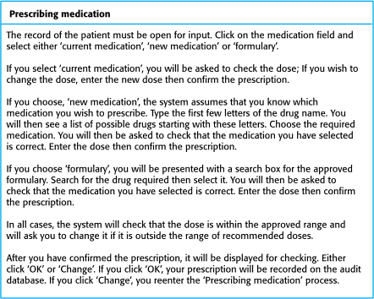
ARequirements scenarios —— ‘prescribing medication’ story
User requirements are expressed as scenarios or user stories.
Chapter 3 Agile software development
Notes:
Prescribe：指定、处方 medication：药物 formulary：处方一览表

Slide 18
Examples of task cards for prescribing medication
Break the requirements into implementation tasks
Chapter 3 Agile software development

Slide 19
Refactoring
This improves the understandability of the software and so reduces the need for documentation.
Changes are easier to make because the code is well-structured and clear.
However, some changes requires architecture refactoring and this is much more expensive.
Chapter 3 Agile software development

Slide 20
Examples of refactoring
Re-organization of a class hierarchy to remove duplicate code.
Tidying up and renaming attributes and methods to make them easier to understand.
The replacement of inline code with calls to methods that have been included in a program library.
Chapter 3 Agile software development

Slide 21
Testing in XP
Testing is central to XP and XP has developed an approach where the program is tested after every change has been made.
XP testing features:
Test-first development.
Incremental test development from scenarios.
User involvement in test development and validation.
Automated test harnesses are used to run all component tests each time that a new release is built.
Chapter 3 Agile software development

Slide 22
Test-first development
Writing tests before code clarifies the requirements to be implemented.
Tests are written as programs rather than data so that they can be executed automatically. The test includes a check that it has executed correctly.
Usually relies on a testing framework such as Junit.
All previous and new tests are run automatically when new functionality is added, thus checking that the new functionality has not introduced errors.
Chapter 3 Agile software development

Slide 23
Test case description for dose checking
Chapter 3 Agile software development

Slide 24
Pair programming
In XP, programmers work in pairs, sitting together to develop code.
This helps develop common ownership of code and spreads knowledge across the team.
It serves as an informal review process as each line of code is looked at by more than 1 person.
It encourages refactoring as the whole team can benefit from this.
Chapter 3 Agile software development

Slide 25
Agile project management
The standard approach to project management is plan-driven. Managers draw up a plan for the project showing what should be delivered, when it should be delivered and who will work on the development of the project deliverables.
Agile project management requires a different approach, which is adapted to incremental development and the particular strengths of agile methods.
Chapter 3 Agile software development

Slide 26
Scrum
The Scrum approach is a general agile method but its focus is on managing iterative development rather than specific agile practices.
There are three phases in Scrum.
The initial phase is an outline planning phase where you establish the general objectives for the project and design the software architecture.
This is followed by a series of sprint cycles, where each cycle develops an increment of the system.
The project closure phase wraps up the project, completes required documentation such as system help frames and user manuals and assesses the lessons learned from the project.
Chapter 3 Agile software development

Slide 27
The Scrum process
Chapter 3 Agile software development

Slide 28
The Sprint cycle
Sprints are fixed length, normally 2–4 weeks. They correspond to the development of a release of the system in XP.
The starting point for planning is the product backlog, which is the list of work to be done on the project.
The selection phase involves all of the project team who work with the customer to select the features and functionality to be developed during the sprint.
Chapter 3 Agile software development

Slide 29
The Sprint cycle
Once these are agreed, the team organize themselves to develop the software. During this stage the team is isolated from the customer and the organization, with all communications channelled through the so-called ‘Scrum master’.
The role of the Scrum master is to protect the development team from external distractions.
At the end of the sprint, the work done is reviewed and presented to stakeholders. The next sprint cycle then begins.
Chapter 3 Agile software development

Slide 30
Teamwork in Scrum
The ‘Scrum master’ is a facilitator who arranges daily meetings, tracks the backlog of work to be done, records decisions, measures progress against the backlog and communicates with customers and management outside of the team.
The whole team attends short daily meetings where all team members share information, describe their progress since the last meeting, problems that have arisen and what is planned for the following day.
This means that everyone on the team knows what is going on and, if problems arise, can re-plan short-term work to cope with them.
Chapter 3 Agile software development

Slide 31
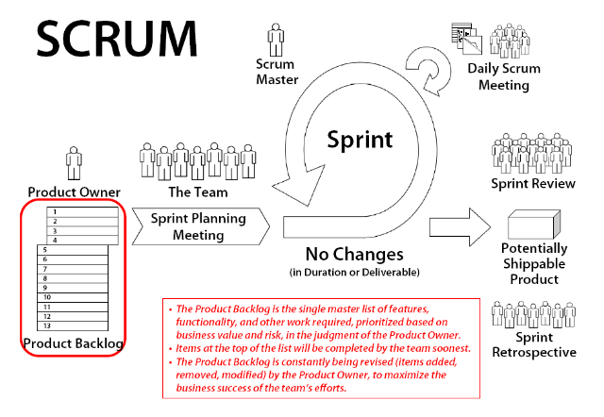
Notes:
Retrospective:有追溯力的

Slide 32
Scrum benefits
The product is broken down into a set of manageable and understandable chunks.
Unstable requirements do not hold up progress.
The whole team have visibility of everything and consequently team communication is improved.
Customers see on-time delivery of increments and gain feedback on how the product works.
Trust between customers and developers is established and a positive culture is created in which everyone expects the project to succeed.
Chapter 3 Agile software development
Notes:
hold up ：阻碍

Slide 33
Scaling agile methods
Agile methods have proved to be successful for small and medium sized projects that can be developed by a small co-located team.
It is sometimes argued that the success of these methods comes because of improved communications which is possible when everyone is working together.
Scaling up agile methods involves changing these to cope with larger, longer projects where there are multiple development teams, perhaps working in different locations.
Chapter 3 Agile software development

Slide 34
Scaling out and scaling up
‘Scaling up’ is concerned with using agile methods for developing large software systems that cannot be developed by a small team.
‘Scaling out’ is concerned with how agile methods can be introduced across a large organization with many years of software development experience.
When scaling agile methods it is essential to maintain agile fundamentals
Flexible planning, frequent system releases, continuous integration, test-driven development and good team communications.
Chapter 3 Agile software development

Slide 35
Scaling up to large systems
For large systems development, it is not possible to focus only on the code of the system. You need to do more up-front design and system documentation
Cross-team communication mechanisms have to be designed and used. This should involve regular phone and video conferences between team members and frequent, short electronic meetings where teams update each other on progress.
Continuous integration, where the whole system is built every time any developer checks in a change, is practically impossible. However, it is essential to maintain frequent system builds and regular releases of the system.
Chapter 3 Agile software development

Slide 36
Key points
Agile methods are incremental development methods that focus on rapid development, frequent releases of the software, reducing process overheads and producing high-quality code.
Extreme programming is a well-known agile method that integrates a range of good programming practices such as frequent releases of the software, continuous software improvement and customer participation in the development team.
A particular strength of extreme programming is the development of automated tests before a program feature is created. All tests must successfully execute when an increment is integrated into a system.
The Scrum method is an agile method that provides a project management framework. It is centred round a set of sprints, which are fixed time periods when a system increment is developed.
Chapter 3 Agile software development

